Slide 1
Driving Insights: Predictive Modeling, Market Analysis, and Data Visualization for Vehicle Sales Optimization for Go Auto
True Auto Value
Group members:
Jasraj Singh
Jaspinder Singh
Parthavi Sharma
Yungvir Singh
CMPT-3830-Machine Learning Work Integrated Learning-1-2025 Winter
February 13, 2025

Slide 2
Introduction to Go Auto's Dataset
Source: CBB Listings dataset
Dataset Overview:
Number of entries: 145114
Number of columns: 46
Key features of the dataset:
Vehicle Characteristics: Year, Make, Price, Mileage, Model, Fuel Type, Transmission Type.
Listing Information: Id, listing type, days on market
Dealer Information: dealer id, dealer name, dealer_phone, dealer_type.

Slide 3
Problem Statement
Pricing Model (Regression): Develop a machine learning model to predict the optimal vehicle pricing based on its characteristics.
Why?
By predicting vehicle prices accurately, dealerships can optimize pricing strategies, attract more buyers, and improve profitability.

Slide 4
Understanding Exploratory Data Analysis (EDA)
What is EDA?
EDA is the process of analyzing datasets using various numerical methods and graphical tools to uncover patterns, trends, anomalies, and underlying structures, helping to confirm expected findings and discover unexpected insights.
Why EDA?
It maximizes insights by uncovering structures, extracting key variables, detecting outliers, testing assumptions, and determining optimal factor settings.
Techniques used
Data inspection & Cleaning: (Load data, check structure, handle missing values, duplicates, and errors).
Descriptive Analysis: Calculate summary statistics (mean, median) and explore individual variables using visualizations.
Relationship Analysis: Examine correlations, relationships between variables using scatter plots & correlation matrices.
Outlier Detection & Visualization: Identify outliers through boxplots and visualize trends and patterns using
charts like heatmaps and box plots.

Slide 5
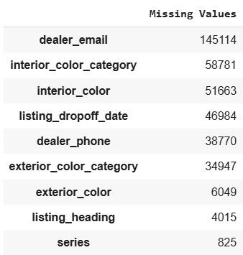
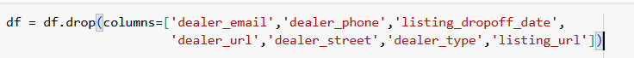
EDA on Dataset
Missing Data: Several columns in the dataset contained missing values.
Imputation: Missing values were handled by replacing them with the mode of each respective column to retain the dataset's structure without introducing bias.
Column Removal: Certain columns with high amounts of missing data or irrelevant information were dropped.

Slide 6
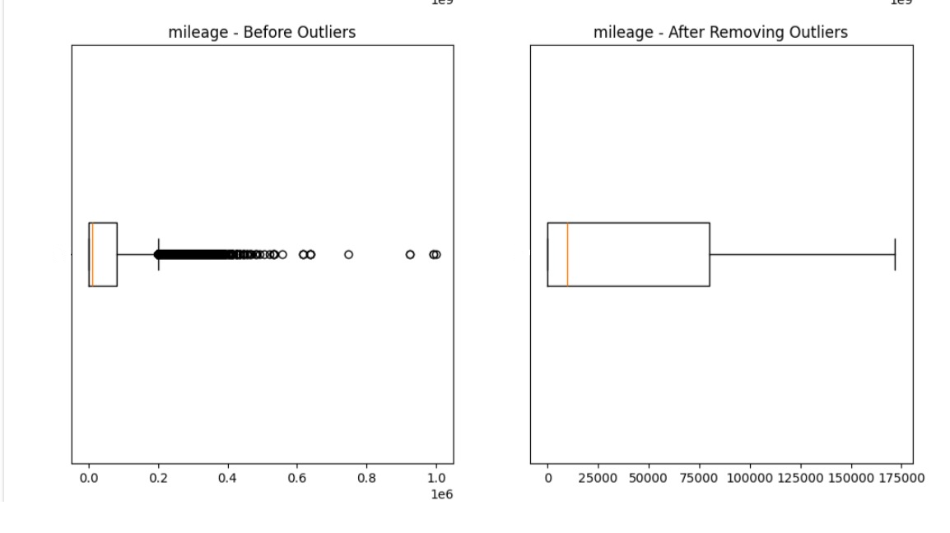
EDA on Dataset
Outliers were detected across several columns using the Interquartile Range (IQR) method.
Example (Mileage):
Before Removal: A wide spread of outliers was observed in the boxplot.
After Removal: Outliers were removed, resulting in a more focused and reliable dataset.

Slide 7
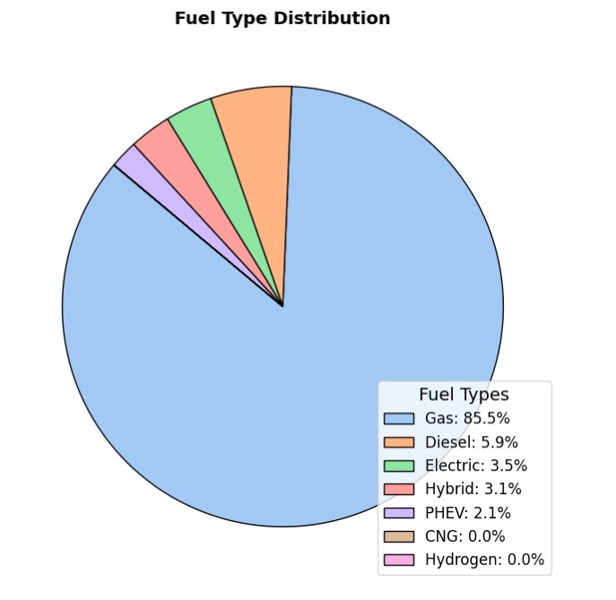
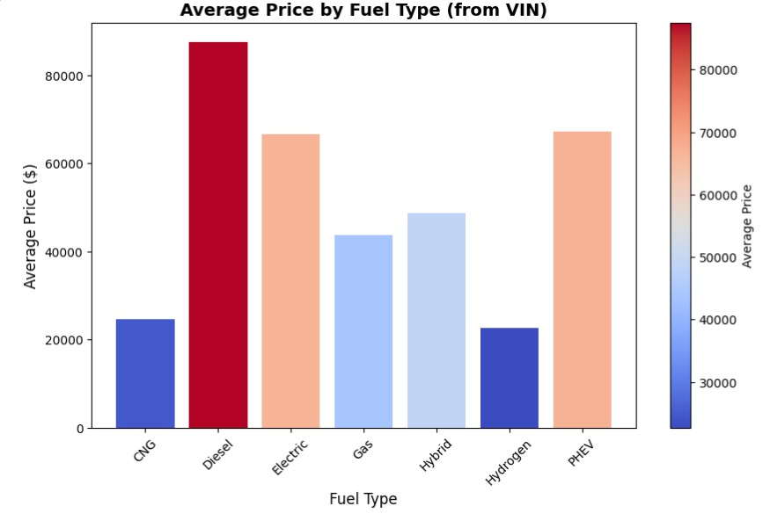
Fuel Type Distribution
The Bar Graph provides a quick overview of the average prices of vehicles based on fuel type. It highlights that Diesel vehicles have the highest average price, while CNG and Hydrogen have the lowest.
The pie chart shows that gasoline-powered vehicles are overwhelmingly dominant in this dataset, while diesel vehicles make up a small fraction. Alternative fuel vehicles have very low representation.

Slide 8
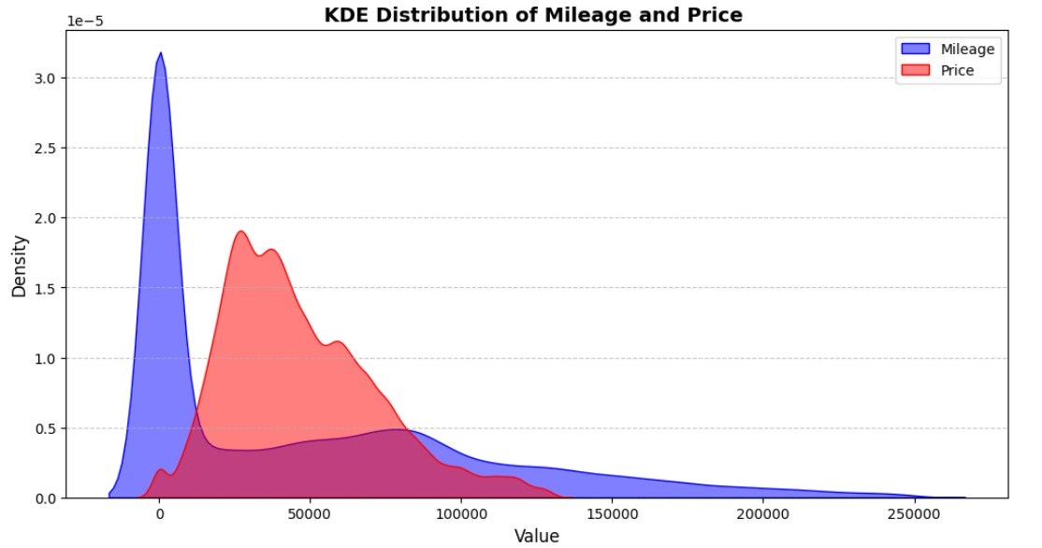
KDE Distribution of Mileage and Price
This KDE plot shows how common different mileages and prices are for cars, revealing that Mileage is heavily skewed towards lower values while Price has a more spread-out distribution with potential multiple peaks.

Slide 9
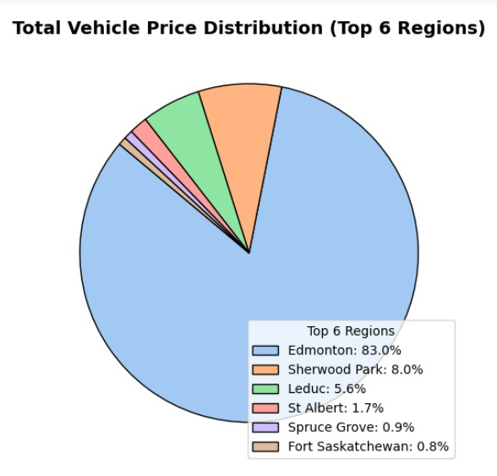
Total Vehicle Price Distribution (Top 6 Regions)
The pie chart shows a strong dominance of Edmonton in the total vehicle price distribution, suggesting it's the primary market for vehicle sales in the region. The other regions contribute significantly less, indicating a potential concentration of sales activity and possibly economic activity in Edmonton.

Slide 10
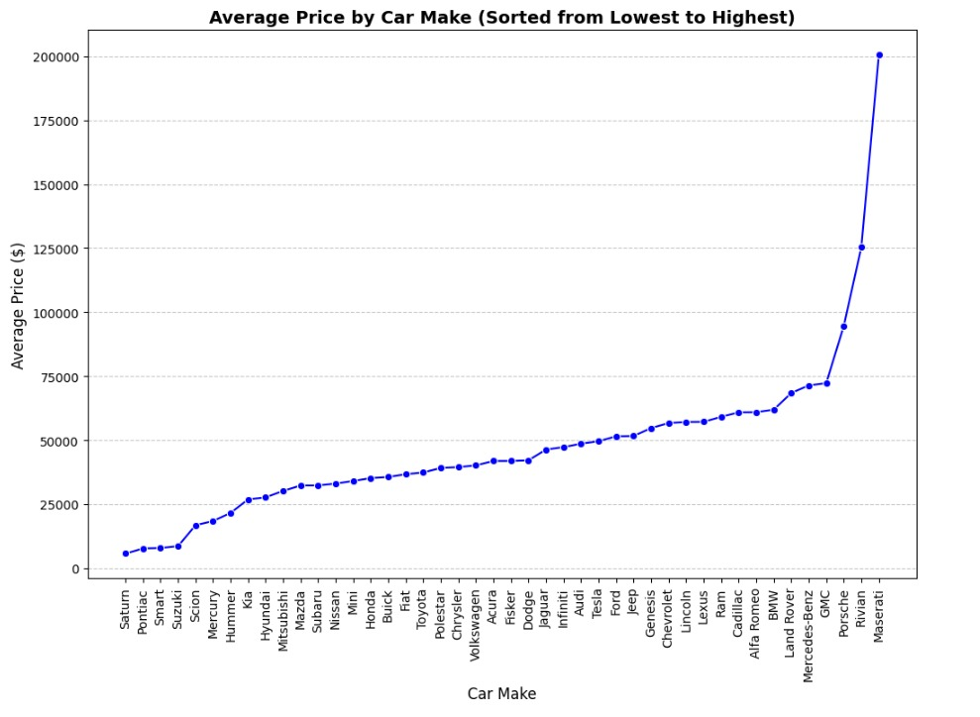
Average Price by Car Make
The line graph provides a clear visualization of average car prices by make, revealing a wide range of price points and highlighting the market segmentation from budget-friendly to luxury vehicles.

Slide 11
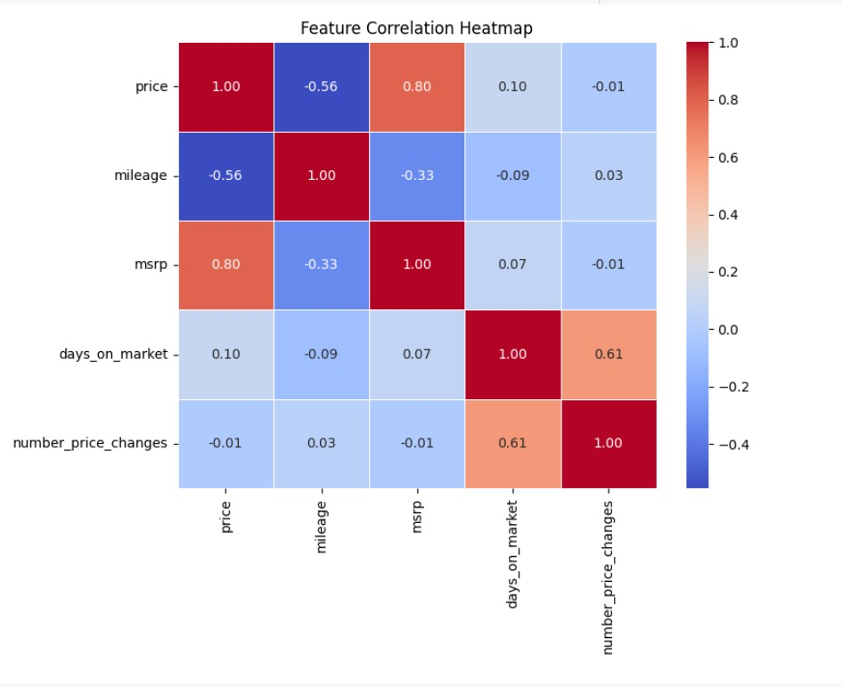
Correlation Heatmap
This heatmap shows how car features relate. Price is strongly tied to MSRP (high positive correlation) and negatively to mileage (moderate negative). Mileage also has a moderate negative link to MSRP. Days on market and number of price changes are moderately positively correlated.

Slide 12
Key Findings
Edmonton leads in vehicle sales.
Diesel vehicles are the most expensive; alternative fuels remain less popular.
Low-mileage cars are in higher demand.
Price & Mileage significantly impact sales trends.

Slide 13
Thank You

